Slide 1
Med Tac Training Program
November 2nd from 8:00 AM to 2:00 PM
Saddleback Church Lake Forest Campus
1 Saddleback Parkway, Lake Forest, CA
What
We will be teaching Bystander Care targeting the 8 leading causes of death of children, youth, and young adults. See our Orange County Video at www.MedTacOC.org . See the article describing the program in Campus Safety Magazine, https://www.campussafetymagazine.com/news/what-is-bystander-care/.
CPR-AED Certification: We will be teaching the American Heart Association CPR program including hands only CPR in the basic course that will be done by 2:00 PM. Those who want to earn AHA Heartsaver certification may do so and finish at 4:00 PM.
Stop-the-Bleed Training: All attendees will earn the American College of Surgeons Stop-the-Bleed certificate. Those who qualify, such as security teams, EMT’s, and those with medical professional backgrounds including school nurses, physicians, and PAs, will be able to be certified as instructors. Attendees will learn wound pressure, tourniquet application, and wound packing.
Anaphylaxis, Heimlich, Opioid OD, and Common Accidents: We will be providing training to address the other most common causes of death including how to use the proper tools such as Epi Pens, Narcan, and certain prevention methods.
Who
Training is for anyone over 10 years of age. The program is especially designed to help leaders at schools, churches, communities, and Scout groups start their own programs. Those with prior Med Tac training can earn CPR/AED cards.
School Nurses, Athletic Trainers, Coaches, and Security Teams: Nurses will earn Continuing Education Units (CEUs). The critical bystander care know-how and skills to save the lives of children, youth, and adults will be covered.
Scout Leaders, Scouts, and Scout Families: All Scouts from OC will be invited to participate including their leaders and their families. A number of the first aid requirements for rank advancement and merit badges will be covered. Instruction regarding how to start a Med Tac Program and service project with your troop will also be covered.
Orange County Scout Leadership and Staff: The staff and leaders of the Boy Scouts OC Council are invited to join us including staff from their camps and the Irvine Outdoor Education Center.
Saddleback Church Security and Health Ministry: All security and health ministry staff and volunteers across all of the campuses are invited. Many have had the basic training and will get to practice teaching Stop-the-Bleed and several the skills necessary to become instructors.
Worship Center Teams and Leaders: Given the rise in active shooter events at worship centers, we are inviting any and all faith-based security and health ministry teams to join us for this first event and all events we host in the future.
Youth Ministry Teams: Anyone from the Saddleback Student Ministry, youth ministries, KSG leaders, and any of the programs for children, youth, and young adults are encouraged to attend. We welcome any faith-based leaders in OC.
Any Saddleback Church Staff or Volunteers: Depending on their backgrounds, they can receive training for the basic Med Tac certification, and if they want to be trainers, they may do so if they qualify as first responders.
Why
Professional first responders arrive approximately 10 minutes after a call is made. By administering bystander care to children, youth, and adults within 3 minutes, there is an enormous gain of saved lives and long-term harm prevented. We will tackle the 8 most common preventable causes of death such as sudden cardiac events, bleeding, choking, opioid overdose, and anaphylaxis. Our battle is “failure to rescue.” You can win that battle with this training.
When
Registration will begin at 7:00 AM. The basic program will start promptly at 8:00 AM and finish at 2:00 PM. The train-the-trainer and full CPR/AED session ends at 4:00PM to allow completion of the American Heart Association process.
Where
The meeting site is Saddleback Church, Lake Forest Campus at 1 Saddleback Parkway, Lake Forest, CA 92630. We will provide a map to the the Refinery Building when you register. Register in the lobby for your passport and message notes.
How to Register
Register by filling out, scanning, and emailing or faxing the attached form to Saddleback@MedTacOC.org or by filling out the online registration form at www.MedTacOC.org
How Much – FREE!
The training is ENTIRELY FREE. A complementary lunch will be provided. Those who want to complete the full American Heart Association Heartsaver ® CPR/AED training to receive their official card will only pay the registration and book fee of $26. Families are welcome!
10-03-19

Slide 2
Med Tac Training Program
November 2nd from 8:00 AM to 2:00PM
Saddleback Church Lake Forest Campus
1 Saddleback Parkway, Lake Forest CA
HOW TO REGISTER:
Fill out this form and email to Saddleback@MedTacOC.org or fax to 512-479-1671.
OR Go to www.MedTacOC.org and fill out the online registration form.
REGISTRATION INFORMATION
NAME:____________________ Email Address: ________________ Cell Ph: ____-____-_____
NEW PARTICIPANT TRAINING:
Basic Med Tac Training Certificates: You will earn two certificates: Med Tac and Stop the Bleed with American College of Surgeons. (8:00AM - 2:00 PM)
AHA Heartsaver CPR/AED Certificate in addition to the Med Tac Basic Training. (8:00AM - 4:00 PM and must pay $26 to American Heart Association))
Med Tac Nursing Certificate. (including Continuing Education Units – CEUs) 8:00AM - 2:00 PM without Heartsaver ® CPR/AED Certificate.
Med Tac Health Security Certificate for security and healthcare volunteers who register for this certificate. 8:00AM - 2:00 PM if currently CPR certified. If no current CPR/AED certification, you must stay for Heartsaver ® CPR/AED Certificate. (8:00AM - 4:00 PM)
To become a Stop the Bleed Instructor with the American College of Surgeons
To become be a Full Med Tac Instructor which means both a CPR/AED Instructor with American Heart Association and Stop the Bleed Instructor with the American College of Surgeons.
FOR THOSE WITH PRIOR MED TAC TRAINING:
I have already received a Med Tac Certificate this year, however, want to earn the AHA Heartsaver CPR/AED Certificate. (10:00AM - 2:00 PM and must pay $26 to American Heart Association)
I have already received a Med Tac Certificate this year, however, want to earn the Med Tac Health Security Certificate as a security or medical volunteer for a faith-based organization. (the time required during this session depends on which courses you have already taken with Med Tac. We will follow up.
SPECIAL INTERESTS:
I want to start a Med Tac Program at my organization or in my community.
I want to learn how to run a Med Tac Community Service event to produce Stop the Bleed kits for my school, scout group, or organization.
I would like to become CPR/AED Instructor with the American Heart Association.
I am a professional first responder, professional caregiver, EMT, trainer, or coach and I would like to become a Stop the Bleed instructor with the American College of Surgeons.
CHECK ALL THAT APPLY:
If a School Leader, School Nurse, Security Member, Teacher, or Representative:
School: _____________
Role: _______________
If a Scout or Scout Troop Leader or Parent:
Troop or Pack: _____________
Designate Scout, Scout Leader, or Parent: _________________________________
Rank: _______________
If a Boy Scouts of America Orange County Council Staff or Volunteer:
Role: _____________
Department & Location: ______________ _________________________
If Saddleback Church Staff or Volunteer:
Department and Location: _________________________________
If a Worship Center Security, Volunteer, Staff, or Health Team Member:
Organization: _____________
Role: ____________________________
If a Professional First Responder or Caregiver:
Lifeguard: ________________________
Security Detail: ____________________
Healthcare Professional including EMTs: _________________________________
Other: _________________________________
If CPR/AED Certified and When:
None
American Heart Association
American Red Cross
Date (Optional) __________
Stop the Bleed Training Certifications
None
Stop the Bleed Certified
Prior Med Tac Certifications
Date: ___________
04-14-19
10-04-19

Slide 3
Med Tac Training Program
November 2nd from 8:00 AM to 2:00PM
Saddleback Church Lake Forest Campus
1 Saddleback Parkway, Lake Forest, CA
We are providing multiple offerings for first time participants and prior Med Tac participants who want to earn the American Heart Association CPR/AED certification card. If you are a first timer with us, the first table is for you. If you have already been trained, the second table applies to you. If you want to become a Med Tac instructor, we request that you undertake the full day program from 8:00AM to 4:00PM.
FOR FIRST TIME PARTICIPANTS:
First Time Participant Category | Certifications to be Earned | Time Required Nov 2nd
First Time Scouts, Scout Leaders, and General Public | Basic Med Tac Training Certificates: You will earn two certificates: Med Tac and Stop the Bleed with American College of Surgeons. | 8:00AM - 2:00 PM
 | AHA Heartsaver CPR/AED Certificate in addition to the Med Tac Basic Training. You must pay $26 to American Heart Association for the card. | 8:00AM - 4:00 PM
First Time Nurses and Caregivers who have CPR and Life Support Training | Med Tac Nursing Certificate. (including Continuing Education Units – CEUs) | 8:00AM - 2:00 PM
First Time Security and Healthcare Volunteers for Schools and Faith-based Organizations | Med Tac Health Security Certificate for security and healthcare volunteers who are currently CPR certified. | 8:00AM - 2:00 PM
 | Med Tac Health Security Certificate for security and healthcare volunteers who are NOT currently CPR certified. You must pay $26 to AHA for the card. | 8:00AM - 4:00 PM
First Time Professional First Responders or Caregivers seeking to be Med Tac Instructors | To become a Stop the Bleed Instructor with the American College of Surgeons | 8:00AM - 4:00 PM
 | To become be a Full Med Tac Instructor which means both a CPR/AED Instructor with American Heart Association and Stop the Bleed Instructor with the American College of Surgeons. | 8:00AM - 4:00 PM
FOR PARTICIPANTS WHO HAVE A MED TAC CERTIFICATE: If you already have a Med Tac certificate, and you want to earn the American Heart Association Heartsaver CPR/AED certificate and card, you will not have to attend the whole day program.
See below:
Previously Med Tac Trained | Certifications to be Earned | Time Required Nov 2nd
Scouts, Scout Leaders, and General Public with Med Tac Cert. | AHA Heartsaver CPR/AED Certificate in addition to the Med Tac Basic Training. You must pay $26 to American Heart Association for the card | 10:00AM - 2:00 PM
Security and Healthcare Volunteers for Schools and Faith-based Organizations with Med Tac | Med Tac Health Security Certificate for security and healthcare volunteers who are NOT currently CPR certified. You must pay $26 to AHA for the card. | 10:00AM - 2:00 PM
10-04-19

Slide 4
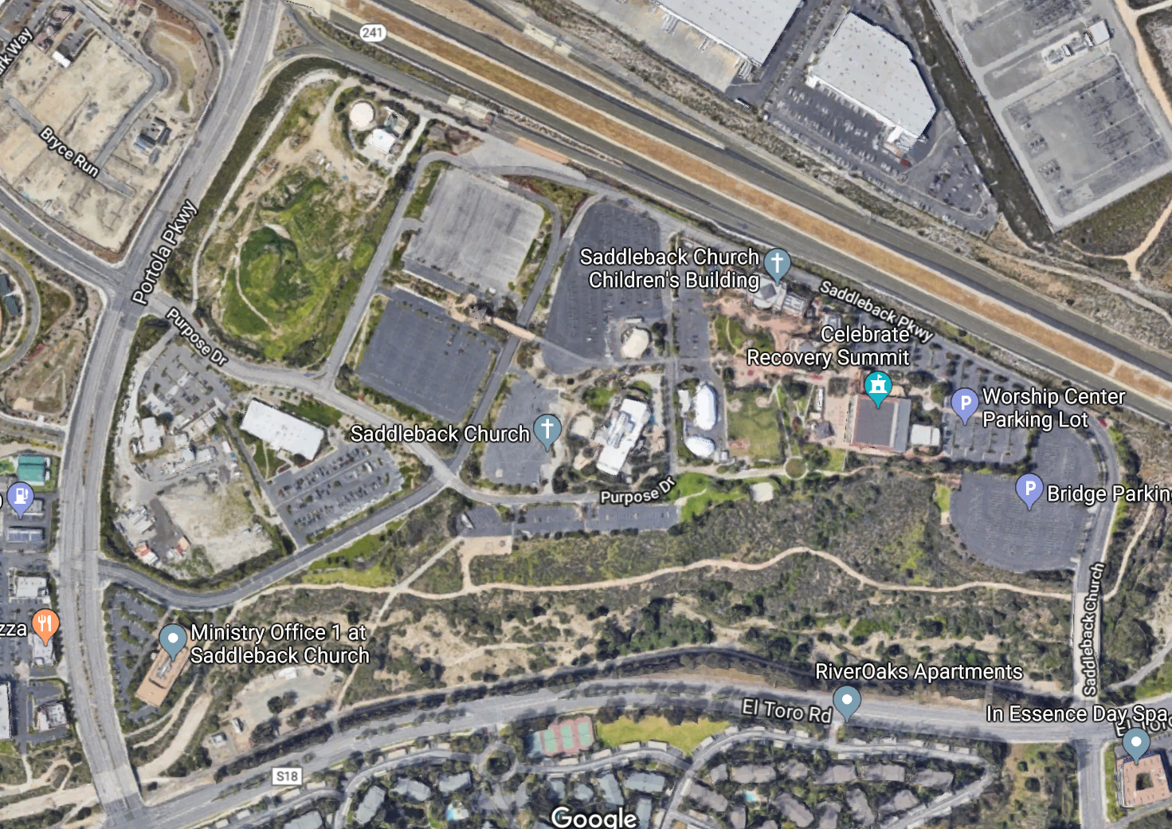
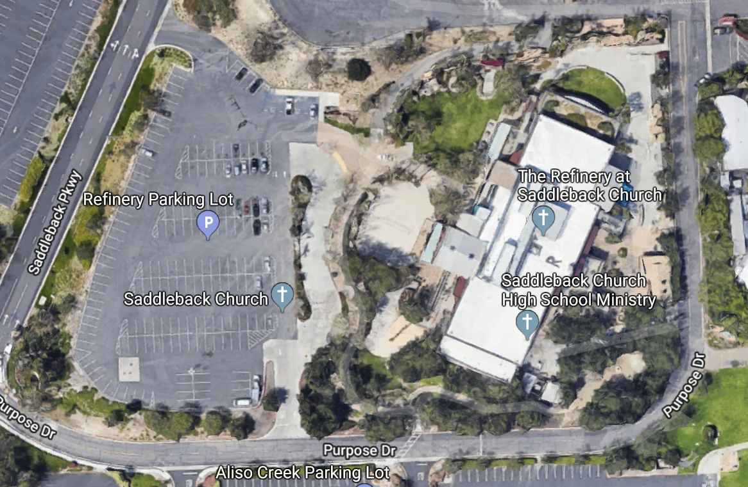
Med Tac Training Program
November 2nd from 8:00 AM to 2:00PM
Saddleback Church Lake Forest Campus
1 Saddleback Parkway, Lake Forest, CA
Go to 1 Saddleback Parkway in Lake Forest, however the church property is quite extensive. You must proceed to The Refinery building designated below.
Park in the Refinery Parking Lot and register in the lobby area. We will direct you to the theater for training.
10-04-19

